Slide 1
Group Project Presentation
IS 669 Big Data and Information Systems
Fall 2023
GROUP 3

Slide 2
Contents
Introduction
Problem Relevance
Problem Statement
Objectives and Goals
Solution Design
Classification Model Predicts
Anticipated Questions and Answers
Conclusion

Slide 3
Introduction
Dataset:
Mushroom Data with 22 Categorical Features and 1 Target Variable and total of 8124 instances.
Project Phases:
Data Exploration, Shaping, Sampling
Database Creation and Table Population
Classification Systems Building (Naive Bayes, Euclidean Distance, Cosine Similarity)

Slide 4
Team Members - Contributions
Uday Kiran Lakkineni: Phase 1 - Data Exploration
Prathyusha Mekala: Phase 1 – Data Shaping & Sampling
Mrunmay Sandeep: Phase 3 – Data Sampling & Classification Systems
Laxman Yadav Musti: Phase 3 - Classification Systems
Srimanth Madira: Overview of Entire Project & Phase 2 - Database Development
Collaboration and teamwork were pivotal in our success, ensuring a cohesive approach to problem-solving, effective communication, and the utilization of each team member's strengths, leading to shared responsibilities and a celebration of collective achievements.

Slide 5
Problem Relevance
Significance of the Problem:
Understanding the categorial features of mushrooms is crucial for determining their edibility. Misclassification could lead to severe health risks, making accurate classification paramount.
Overview of Solution:
Our approach involves two key phases. First, generating synthetic data closely resembling the original dataset to enhance the diversity of our training set. Second, developing a relational database to efficiently store and manage the mushroom data. These steps set the foundation for the subsequent creation of three robust classification systems.

Slide 6
Problem Relevance
Benefits and Potential Impact:
Accurate classification mitigates health risks, aiding informed decisions on mushroom consumption and reducing poisoning risks.
The synergy of synthetic data, a structured database, and classification systems creates a comprehensive solution with potential public health impact.
Enhanced accuracy not only ensures safety but also fosters ongoing research in mushroom classification and analysis.

Slide 7
Problem Statement
Specific Problem:
The primary challenge involves developing accurate and reliable classification systems for mushrooms to distinguish between edible and poisonous varieties. The focus is on creating robust models that effectively leverage categorical features for precise classification.
Type of Data:
The dataset consists of categorical features describing various characteristics of mushrooms, such as cap shape, cap color, odor, and more. The target variable is "poisonous," indicating whether a mushroom is edible (e) or poisonous (p).

Slide 8
Problem Statement
Challenges Anticipated:
Categorical Nature: Dealing with categorical features requires careful consideration for encoding methods, ensuring the effective utilization of this information in the model.
Imbalanced Data: Anticipating potential imbalances in the dataset, as mushrooms may be unevenly distributed between edible and poisonous categories, which can impact the model's ability to generalize.
Interpretation Complexity: Given the diverse nature of mushroom characteristics, understanding the significance of certain features and their impact on classification accuracy poses a challenge.

Slide 9
Objectives and Goals
Intermediate Objectives:
Data Preprocessing:
Cleanse and preprocess the mushroom dataset to address any missing values or inconsistencies.
Explore and understand the dataset through descriptive statistics and frequency distribution.
Synthetic Data Generation:
Create synthetic data to augment the original dataset, enhancing the diversity of samples for more robust model training.
Database Development:
Design and implement a relational database to efficiently store and manage mushroom data for seamless accessibility.

Slide 10
Objectives and Goals
Model Development:
Build three distinct classification systems, including probabilistic, distance-based, and similarity-based models, each leveraging different algorithms.
Model Evaluation:
Utilize the confusion matrix and visualizations as comprehensive tools to gain insights into true positives, false positives, true negatives, and false negatives, ensuring a nuanced understanding of the system's effectiveness.
Overall Goal:
The overarching goal is to develop a comprehensive and accurate mushroom classification solution. This involves creating effective classification models, optimizing their performance, and establishing a reliable database infrastructure for seamless data management.

Slide 11
Objectives and Goals
Importance of Objectives and Ultimate Goal:
Achieving these intermediate objectives is crucial as they collectively contribute to the success of the overall goal. The objectives ensure the dataset is well-prepared, the models are diverse and effective, and the data is efficiently stored. The ultimate goal is essential not only for accurate mushroom classification, which has direct implications for public health but also for advancing research in the field of mushroom analysis. The comprehensive solution aims to enhance accuracy, safety, and the understanding of mushroom characteristics.

Slide 12
Solution Design
Data Insight Extraction:
Using NumPy, we computed descriptive statistics and frequency distribution for the key feature—odor. Notably, the 'n' (none) odor category exhibited the highest frequency, offering vital insights into its prevalence within the mushroom dataset.
Synthetic Diversity Integration:
In a creative approach, we employed the random module to generate synthetic data, specifically focusing on the categorical values. By selecting from distinct values for each feature, we expanded the dataset innovatively, ensuring exposure to a diverse range of potential mushroom characteristics.
Database Synergy for Accessibility:
We utilized MySQL client for database setup and a Python MySQL connection for table population. This ensured a dynamic relational database, aligning seamlessly with the dataset's structure for efficient storage and easy accessibility for future analyses and model improvements.

Slide 13
Solution Design
Algorithmic Diversification:
Adopted a diverse set of algorithms for the creation of three distinct classification systems—each introducing unique perspectives. This approach fosters a holistic understanding of mushroom classification through probabilistic, distance-based, and similarity-based models.
Performance Evaluation Beyond Accuracy:
Departed from conventional accuracy-centric evaluations and delved into the nuanced world of confusion matrices. Precision, recall, and F1 score metrics were strategically employed to provide a comprehensive assessment of classification system performance.

Slide 14
Classification Model Predicts Creating Probabilistic, Distance, and Similarity-Based Classifiers
Probabilistic Classification (Naive Bayes):
Data Preparation: Extracted features (X) and labels (y) from the mushroom dataset.
Cross-Validation: Implemented k-fold cross-validation (k=5) for robust model evaluation.
One-Hot Encoding: Applied one-hot encoding to handle categorical features.
Classifier Training: Trained a Categorical Naive Bayes classifier on each fold of the dataset.
Confusion Matrix: Evaluated performance using confusion matrices for each fold and an overall matrix.
Distance-Based Classification:
Data Preprocessing: Prepared the dataset with one-hot encoding, standardization, and normalization.
Train-Test Split: Implemented a 70-30 train-test split, fostering effective learning and realistic performance assessment.
Template Creation: Calculated class templates based on the mean of each class in the training set.
Distance Calculation: Computed Euclidean distances between test points and class templates.
Classification: Assigned class labels based on the class with the minimum distance.
Confusion Matrix: Evaluated performance using a confusion matrix.

Slide 15
Classification Model Predicts Creating Probabilistic, Distance, and Similarity-Based Classifiers
Similarity-Based Classification:
Data Preprocessing: Encoded features and normalized the dataset.
Time-Based Split: Implemented to preserve temporal order, crucial for accurate cosine similarity calculations.
Cosine Similarity: Computed cosine similarity between test instances and training data.
Classification: Assigned class labels based on the most similar instances in the training set.
Confusion Matrix: Evaluated performance using a confusion matrix.

Slide 16
Classification Model Predicts Challenges & Considerations
Probabilistic Model:
Adapting the probabilistic model to handle categorical features, specifically those related to mushroom characteristics, was a significant challenge. Overcoming this, we strategically employed one-hot encoding through the OneHotEncoder to ensure the model's compatibility with the Categorical Naive Bayes classifier.
Simultaneously, ensuring robust model evaluation introduced complexities, met with the implementation of KFold cross-validation using five splits and a carefully chosen seed for reproducibility.
Distance-Based Model:
Creating representative templates in a high-dimensional feature space presented challenges such as handling outliers, ensuring template robustness across dimensions, and addressing computational complexities.
Feature scaling using StandardScaler was vital for normalizing the dataset, optimizing model performance.

Slide 17
Classification Model Predicts Challenges & Considerations
Similarity-Based Model:
Cosine similarity played a crucial role in capturing feature relationships within a vector space. This approach was essential for effective feature representation in a high-dimensional context, enabling the model to discern patterns accurately and make reliable predictions based on cosine similarity metrics.

Slide 18
Classification Model Predicts Features Used
Probabilistic Model:
All features in the dataset were utilized, encompassing mushroom characteristics such as cap shape, color, odor, gill attributes, and more.
Distance-Based Model:
Similar to the probabilistic model, all available features were considered. The model relies on Euclidean distance for effective measurement of dissimilarity between instances.
Similarity-Based Model:
Utilized all features for comprehensive analysis. The model is built on cosine similarity, enabling effective measurement of feature-based similarities between instances.

Slide 19
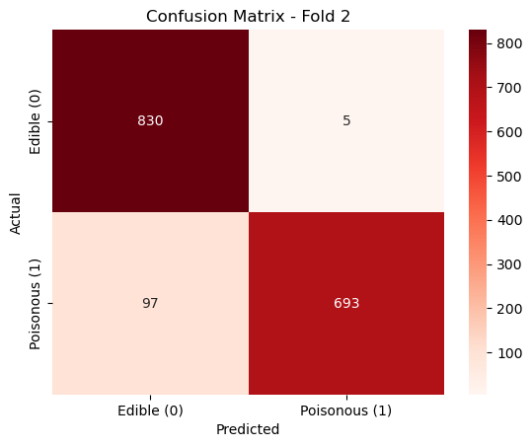
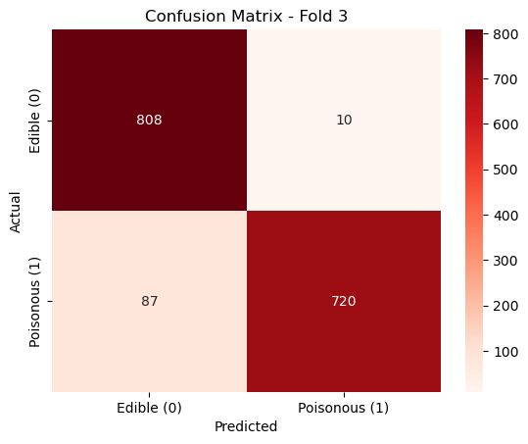

Classification Model Predicts Results & Validation
Probabilistic Model: Consistent performance across folds, demonstrated by confusion matrices.

Slide 20



Classification Model Predicts Results & Validation

Slide 21
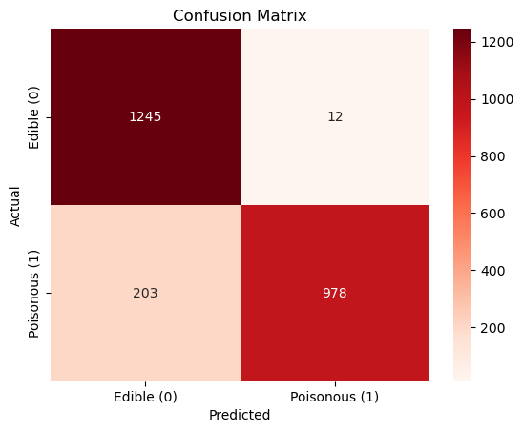
Classification Model Predicts Results & Validation
Distance-Based Model: Notable true positive and true negative counts, indicating reliable discrimination.
True Positive (TP): 978
True Negative (TN): 1245
False Positive (FP): 12
False Negative (FN): 203
Accuracy: 0.89

Slide 22
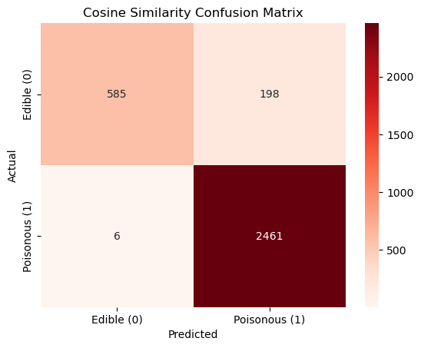
Classification Model Predicts Results & Validation
Similarity-Based Model: Strong discriminatory ability with high true positive and true negative counts.
True Positive (TP): 2461
True Negative (TN): 585
False Positive (FP): 198
False Negative (FN): 6
Accuracy: 0.91

Slide 23
Anticipated Questions?
How did you handle the categorical nature of the features, particularly in the probabilistic model?
What challenges did you face in creating distance-based classifiers, and how were these challenges addressed?
Why did you choose cosine similarity for the similarity-based classifier, and how did it contribute to accurate classification?
How did you address potential imbalances in the dataset, and what impact did it have on the classification models?
Can you elaborate on the significance of the synthetic data generation step in your solution?
Why did you choose the particular train-test split for each model, and how does it enhance model effectiveness?

Slide 24
Conclusion
Collaborative efforts steered us through preprocessing and model implementation.
Innovative data exploration, synthetic data integration, and dynamic database creation showcased our analytical prowess.
Well-tuned probabilistic, distance-based, and similarity-based classifiers deliver robust predictions.
Beyond mushroom classification, our work advances knowledge in data analysis.
Grateful for team synergy, ready for your questions and discussions.

